Slide 1
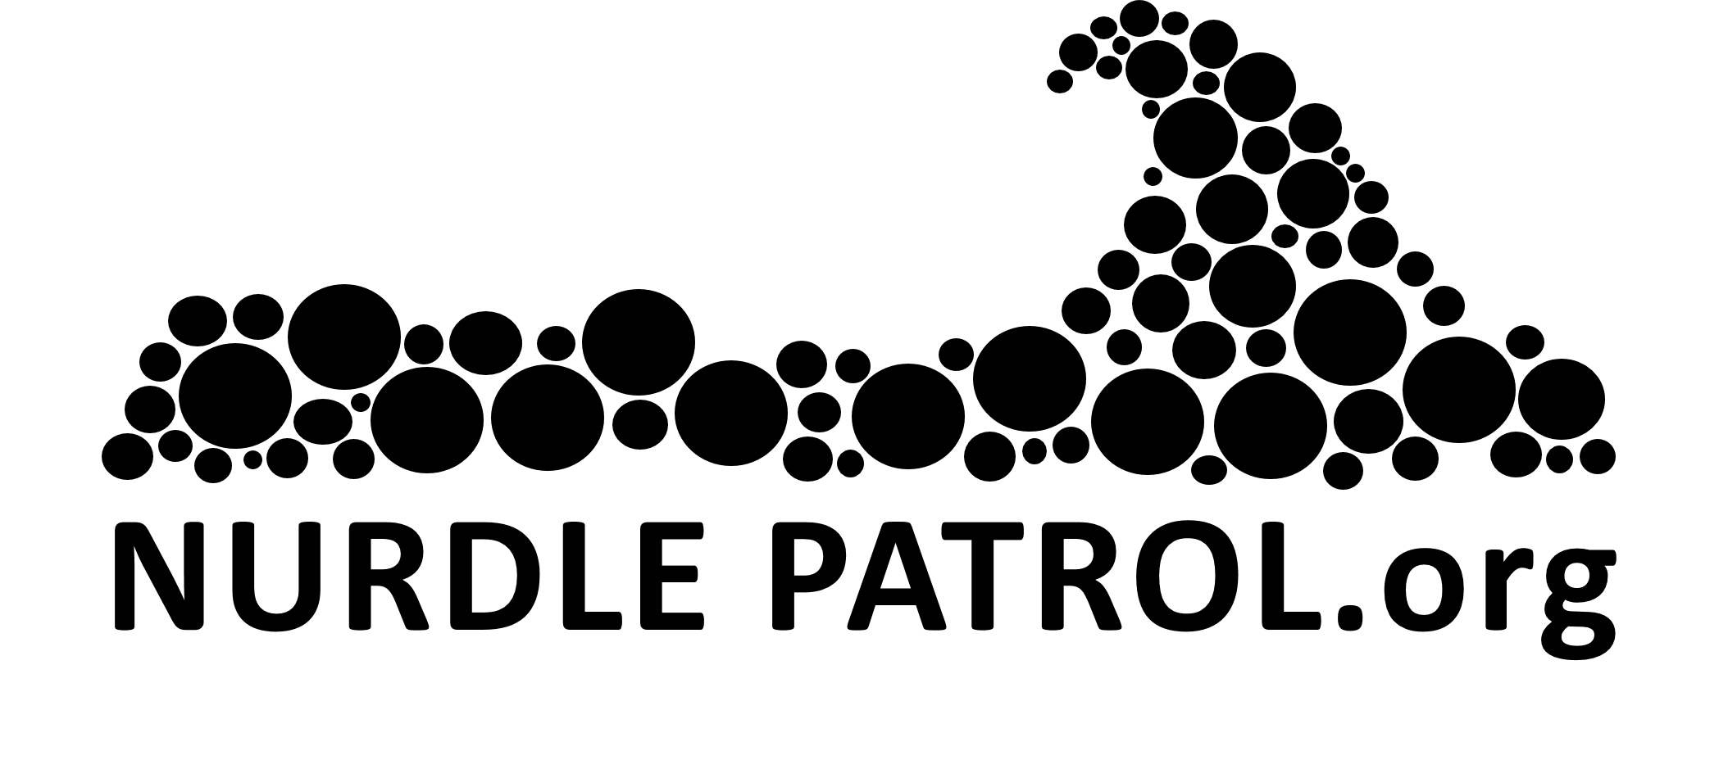
Nurdle Patrol
Name
Organization
Date

Slide 2
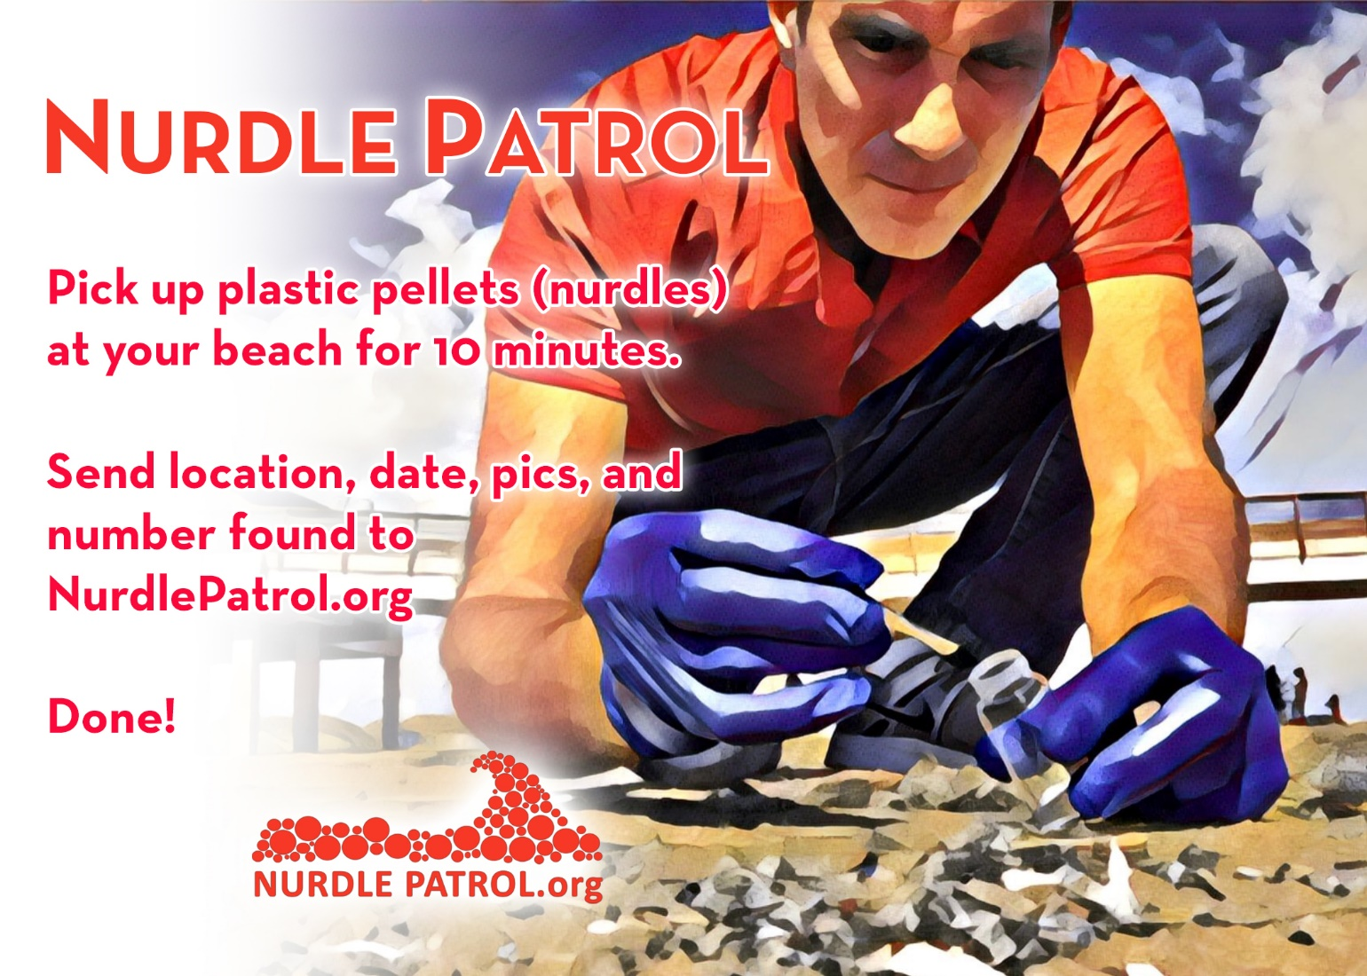
Notes:
Nurdle Patrol is a citizen science project to help find where high concentrations of plastic pellets (nurdles) are found along beaches, rivers, and lakes across the United States. Data helps to create awareness about the plastic pollution entering our waterways, create a database that is used to justify policy changes at the state level for preventing pellets from getting into the environment, and the program removes nurdles from shorelines so that animals cannot eat them.

Slide 3
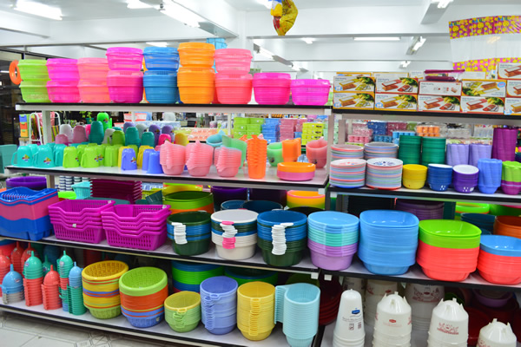
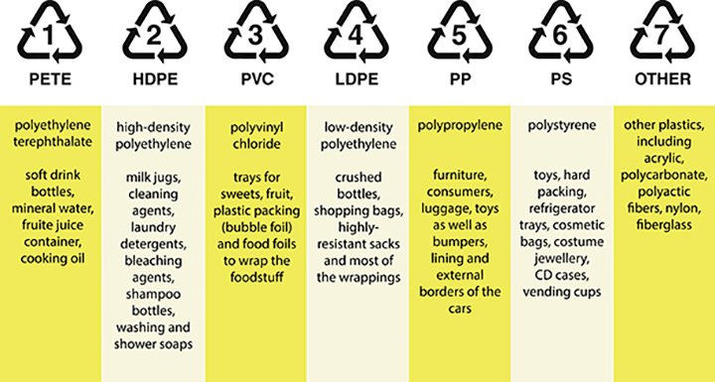
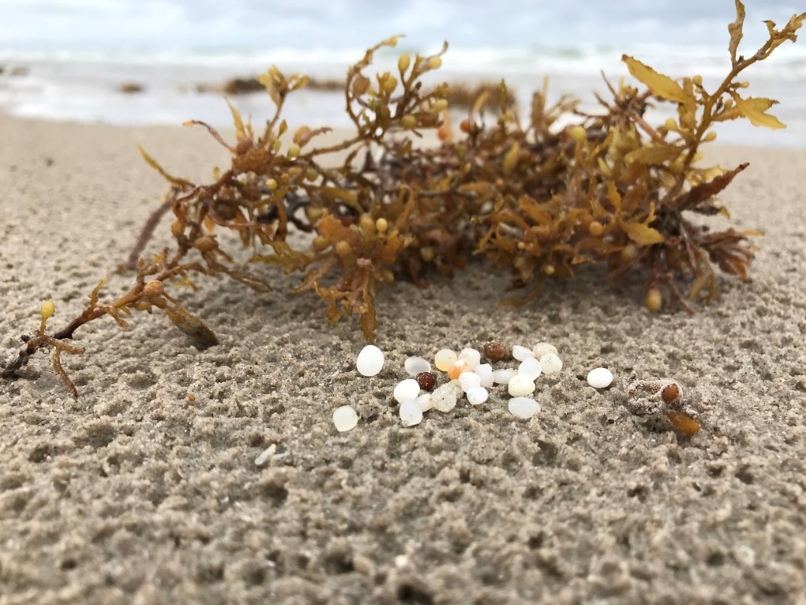
What is a nurdle?
Nurdle – raw plastic
Basis for everything plastic
Notes:
Nurdles are the raw material that almost everything plastic is made from. It is a small plastic pellet the size of a lentil and is considered microplastic. Most of the nurdles being found along shorelines and rivers banks is Low Density Polyethylene (LDPE) and Polypropylene (PP). This is due to the density of the nurdles. The other plastics are also being lost to the environment but sinking in the water due to higher density.

Slide 4
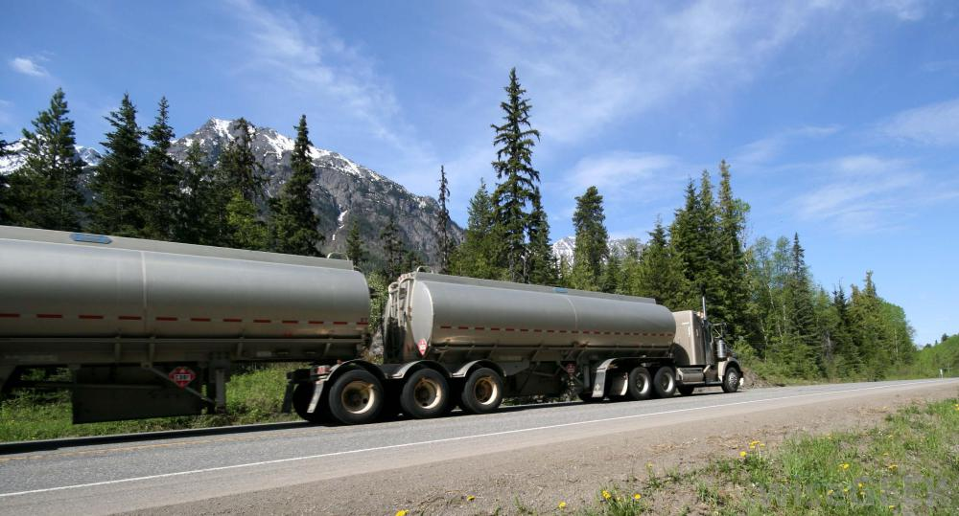
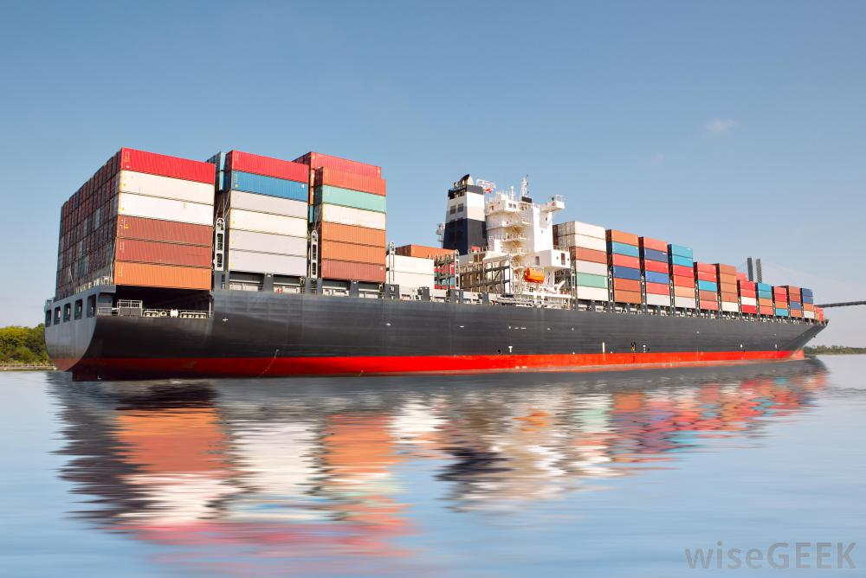
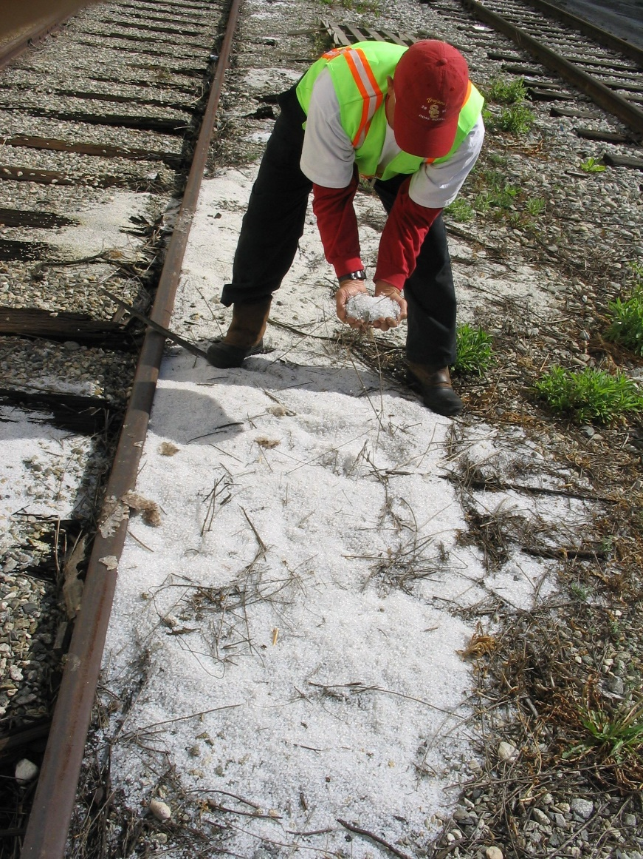
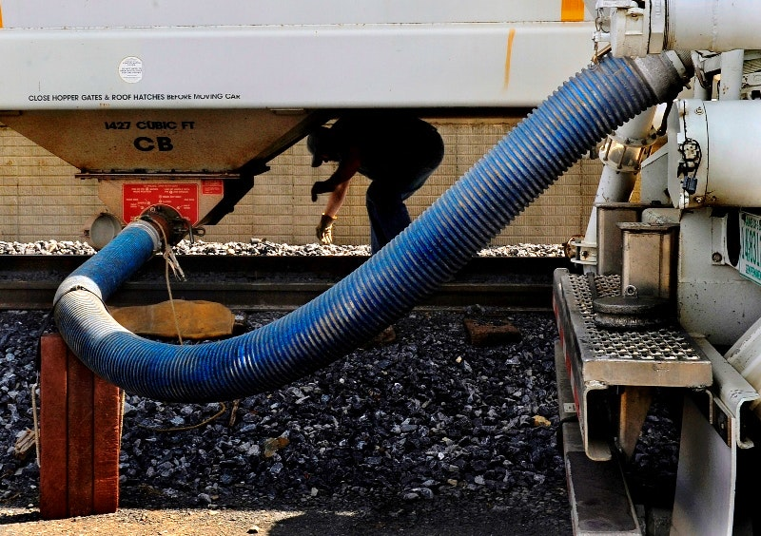
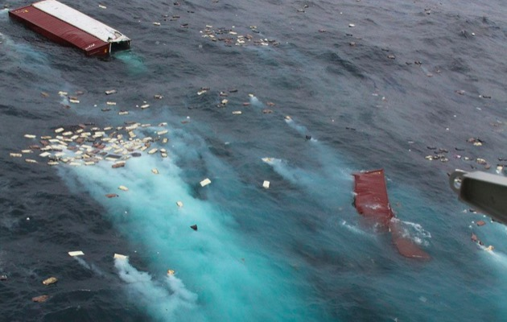
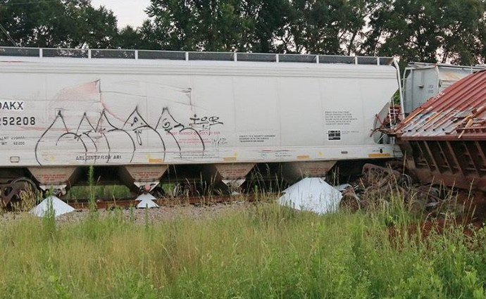
Release to Environment
Notes:
Nurdles can enter the environment through every step of the supply chain, including at the manufacturing site, especially during onloading and offloading of the nurdles from truck or railcar. Railcars and trucks can lose pellets during transportation, and at the factory that eventually melts the plastic pellets down to make a final product. Once pellets fall on the ground, they are subject to rain that lifts them up and carries them to the nearest waterway through stormwater. Everything on the ground eventually ends up in a river, then bay, and ultimately the ocean. Less often spill events that happen include large container ship spills with bags of pellets entering the ocean.

Slide 5
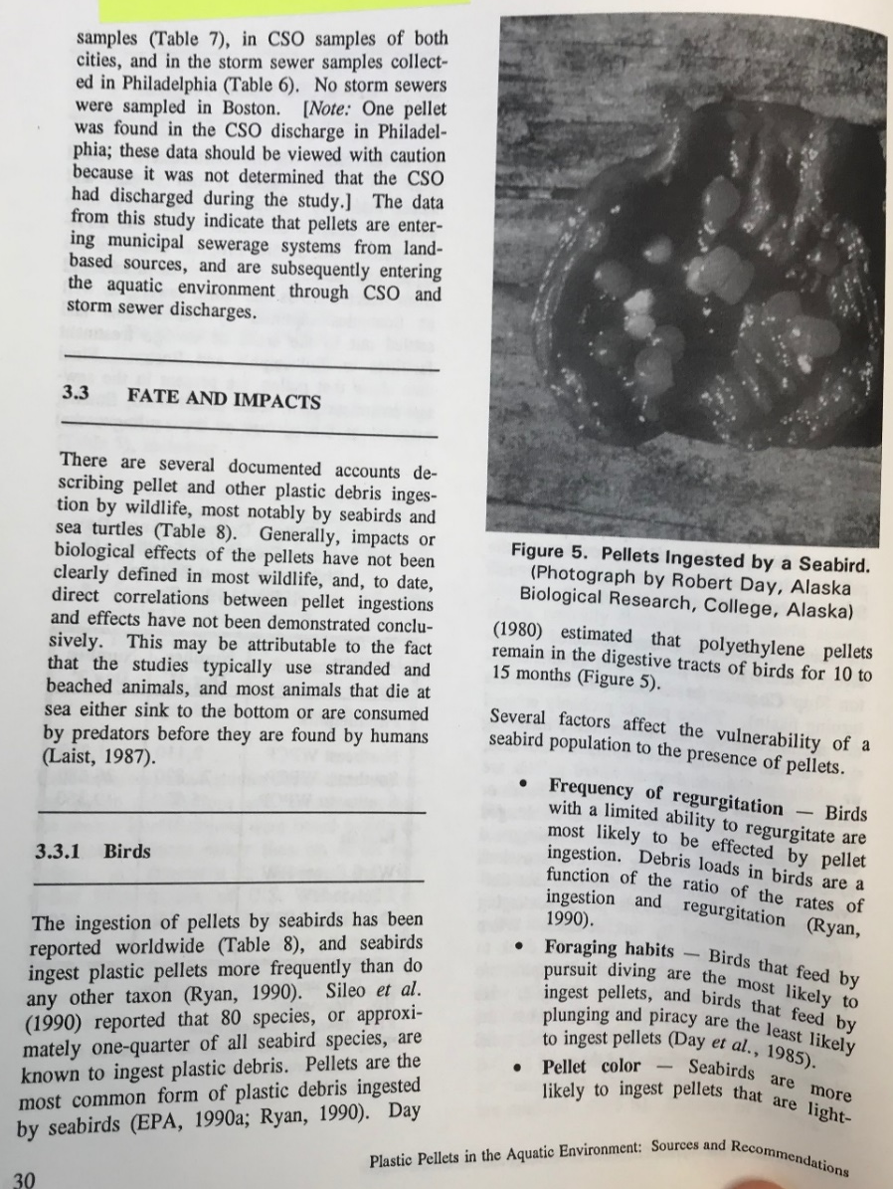
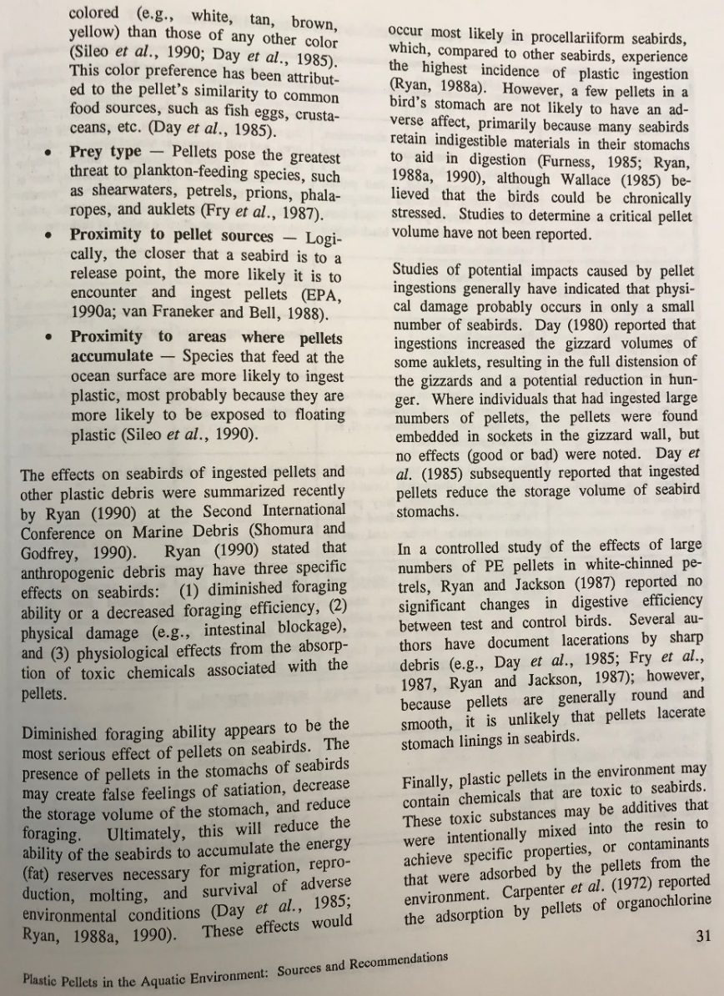
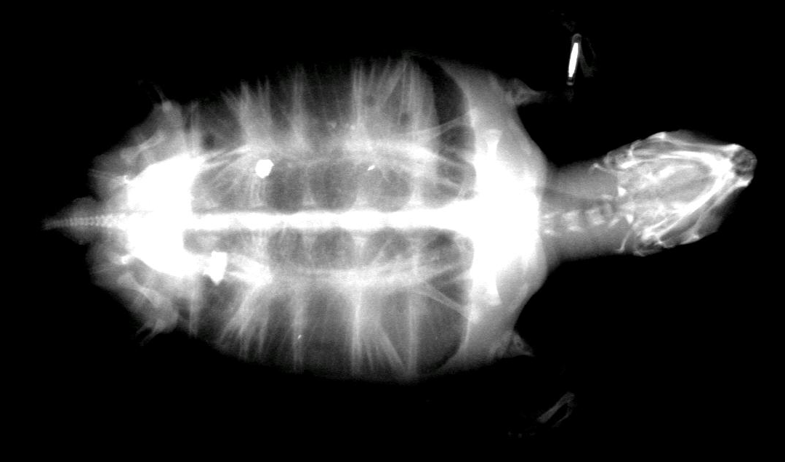
Impacts
1992 EPA Report on Plastic Pellets
Wildlife eat
Absorb chemicals
Aesthetics
Human health
ARK turtle x-ray, September 2018
Notes:
Spills of nurdles has been happening for decades. In 1992, the Environmental Protection Agency wrote a report called “Plastic Pellets in the Aquatic Environment: Sources and Recommendations”. The report lists over 80 species of birds that were known to eat nurdles at that time. Also in the report is a list of sea turtle gut analysis that documented consumption of nurdles, and fish eating the pellets as well. The biggest impact of nurdles in the environment is likely to fish and wildlife. Once nurdles are in the environment, they absorb harmful chemicals such as PCBs, DDTs, and PAHs. These are harmful to the animals when consumed and can be deadly if chemicals are in high enough concentrations. The pellets can also block intestinal tracts of animals, similar to the picture in the 1992 report that shows about 12 nurdles in the bird’s gut. From a human health perspective, we are concerned about fish eating pellets and the chemicals leaching out of the pellets and into the muscle tissue that we eat. That link has not been made yet due to the difficulty of this research, but studies are going on currently that could give us this answer in the next few years.

Slide 6
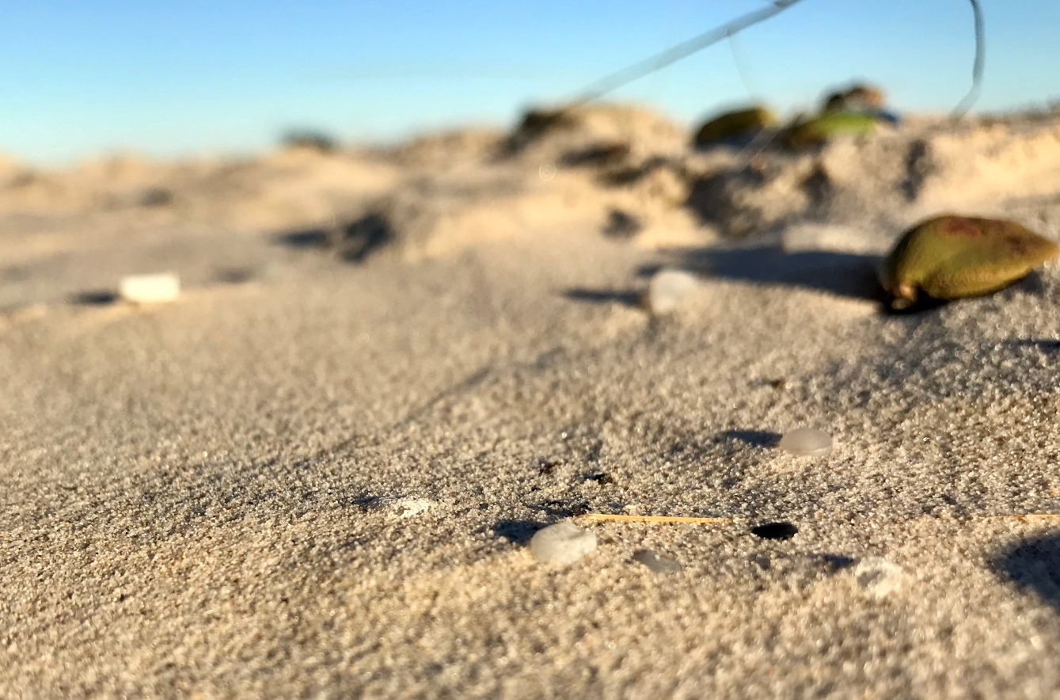
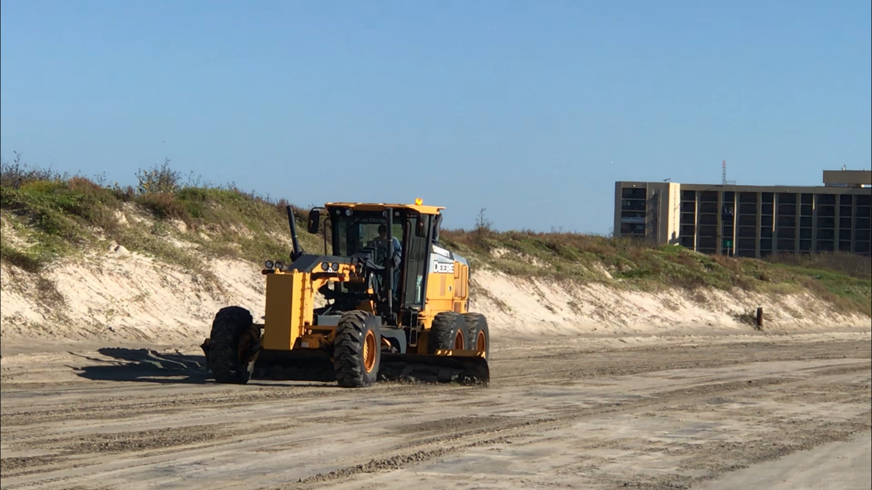
Issues
Beach maintenance
High tides or high water
Driving on beach
Wind blowing sand
Similar with oil spill
Time sensitive to clean up
Notes:
Nurdle spills are similar to an oil spill in that they need to be assessed and cleaned up quickly. High tides, or rising water in rivers can sweep the pellets to different areas, maintenance of beaches for tourists can burry the pellets, wind and rain can scatter the nurdles making it almost impossible to cleanup. When a spill first occurs, pellets are typically concentrated in one location, making it easier to clean up, so it’s important for state and federal agencies to respond quickly.

Slide 7

Citizen Science Project
Notes:
Nurdle Patrol citizen science project was created to document nurdles washing up on beaches and river banks across the U.S. The methodology is to start your clock for 10 minutes once you find your first nurdle, then count how many nurdles you found at the end of the 10 minutes. Then log your data into NurdlePatrol.org. You can do a survey as an individual or as a group, and the database standardizes all data to 1 person for a 10 minute period so that all data inserted into the website can be compared across the country. For more information on the methodology, watch the 4 minute training video.

Slide 8
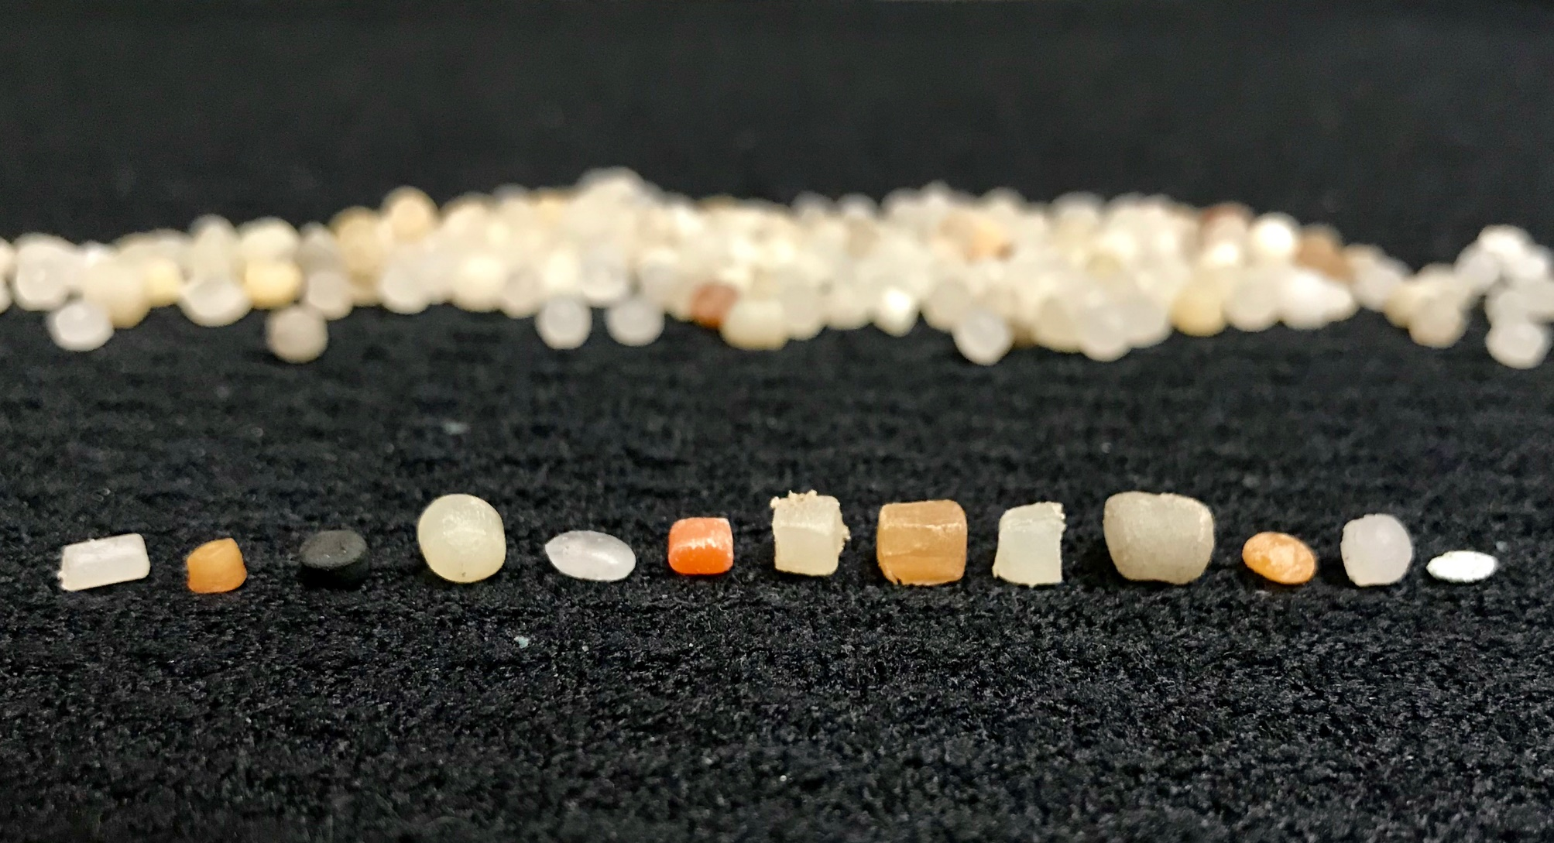
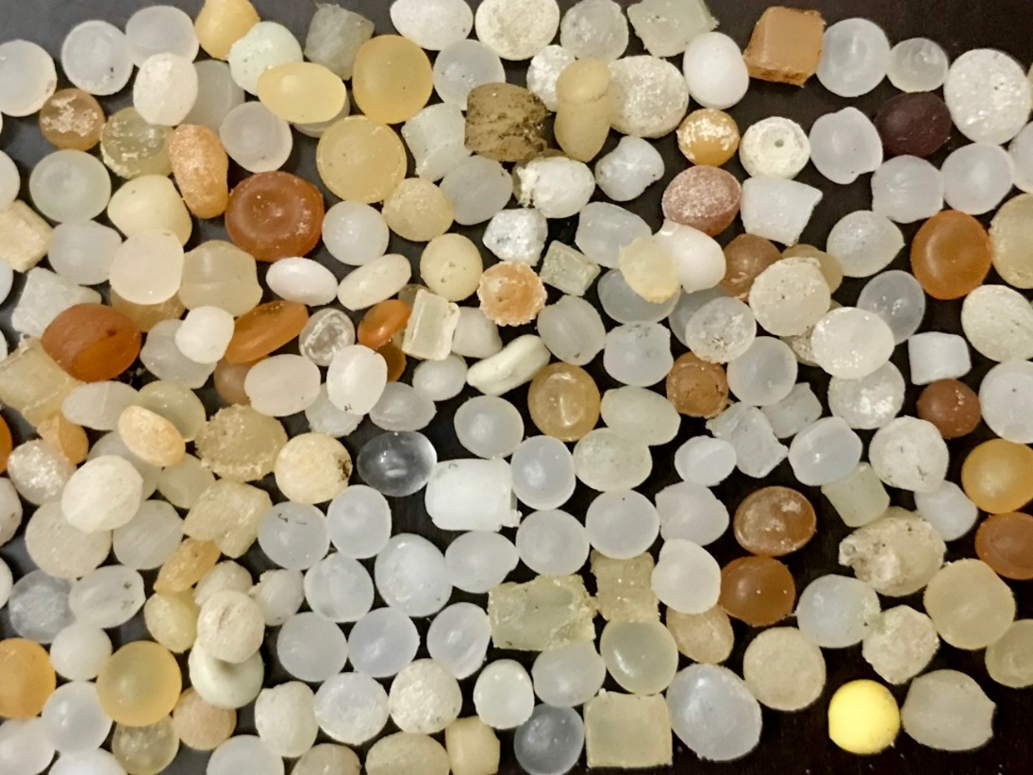
Types being found
Notes:
All types of nurdles are being found, from flat to round, and white to orange to black.

Slide 9
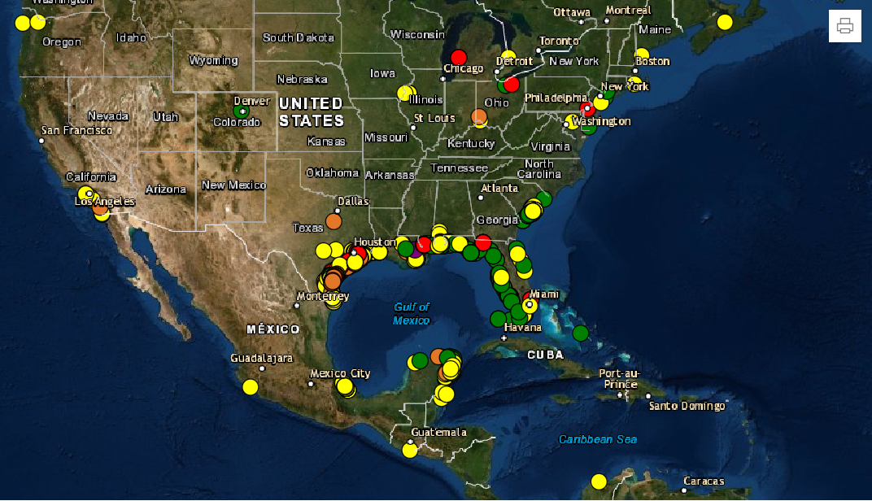
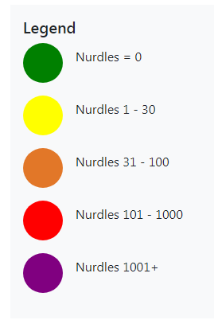
Notes:
Once data is added into NurdlePatrol.org, it is automatically populated into the map on the website, which is similar to google earth in that you can zoom in or out to your community and print a map of your local area with nurdle data. You can print the map digitally or hard copy, and use to show the problem in your community. The color dots show the concentrations of pellets found during a nurdle survey.

Slide 10
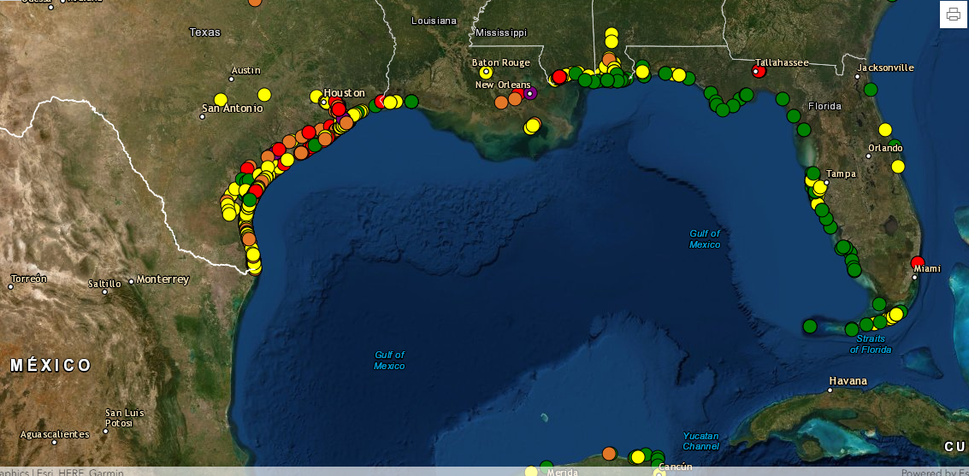
Gulf of Mexico
Notes:
Zooming in closer to an area allows for more detail to be seen.

Slide 11
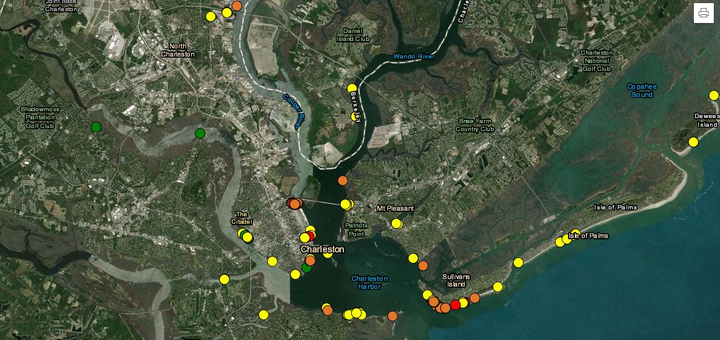
Notes:
This is a map of South Carolina around Charleston, showing how pellets can be found up in the watershed to try and identify the source of pellets. This information can then be used to work with state agencies on a number of different solutions, including stricter stormwater permits for any company handling plastic pellets.

Slide 12
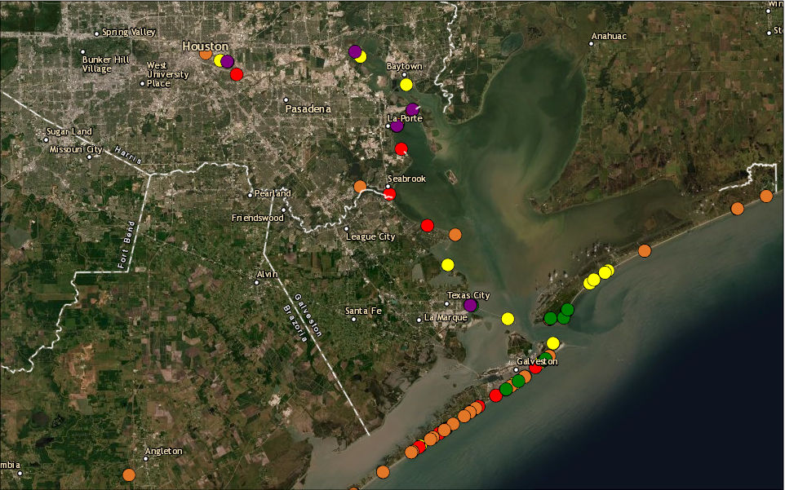
Galveston Bay
Gulf of Mexico
Notes:
This is Galveston Bay where there is the highest concentration of plastic manufacturing sites in the country and is also the bay system that has the highest concentration of plastic pellets being found in a 10-minute period. The highest concentration to date is over 30,000 nurdles in 10 minutes in Galveston Bay. Because of this data, the state of Texas is now working on amending all discharge permits for plastic manufactures and other companies handling nurdles. These discharge permit changes will allow the state inspectors the tools they need to make enforcement changes immediately. Currently, California is the only state in the U.S. that identifies plastic pellets in the discharge permits. Most permits say, “a trace amount of suspended solids is allowed”, which is too vague and is why we are having many of the plastic pellet problems we have today.

Slide 13
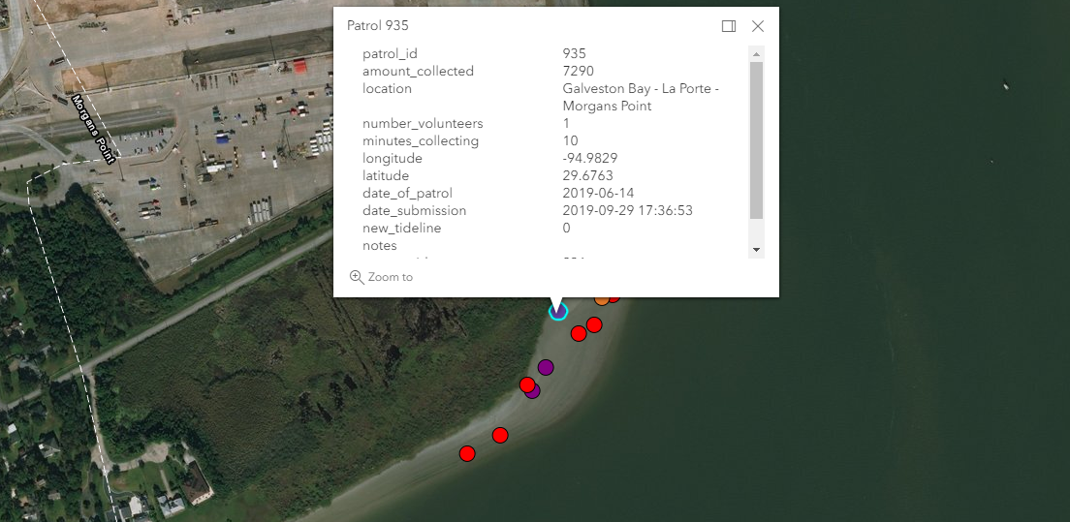
Notes:
When on the nurdle map, you can click on a dot to get all the data for that sample. This particular dot is up in Galveston Bay and you can see that there were 7,290 nurdles collected by 1 person in a 10 minute period on June 14, 2019.

Slide 14
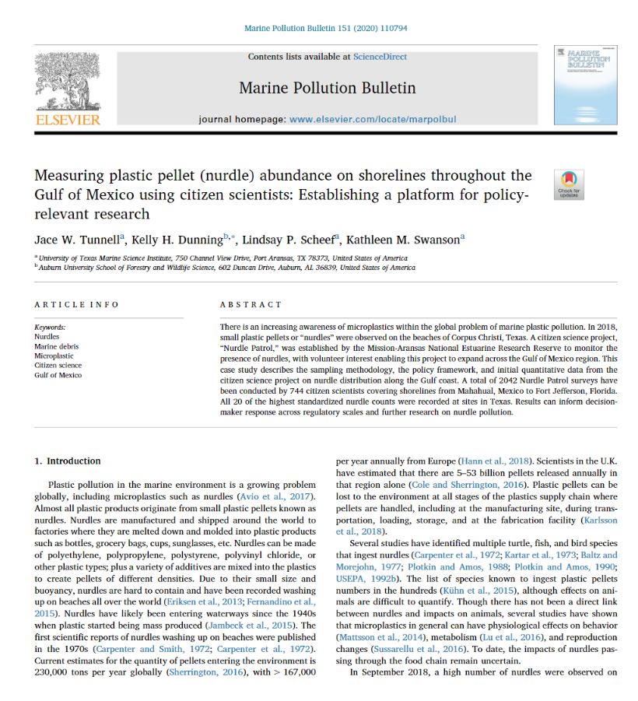
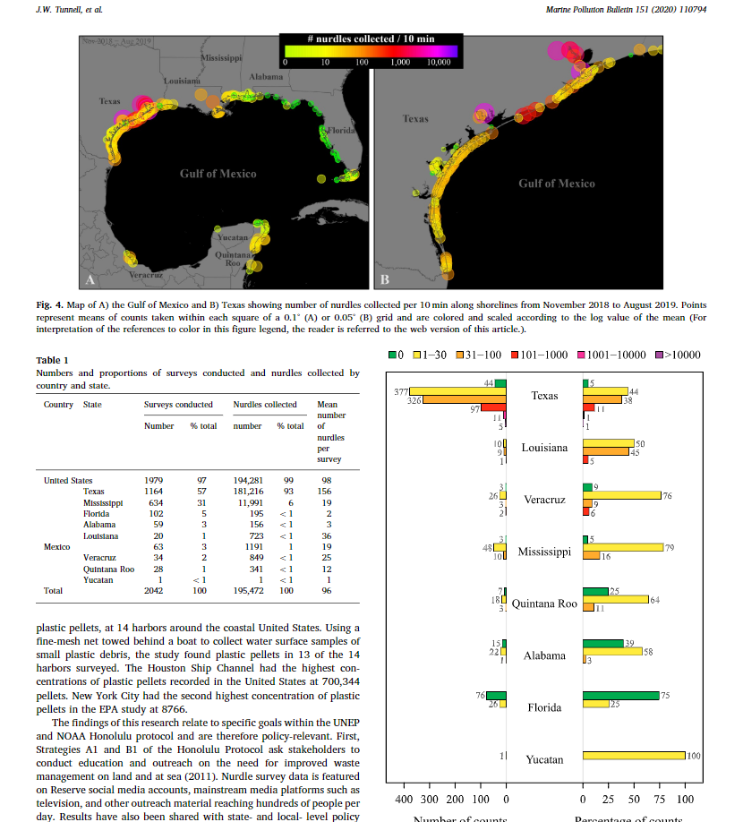
Notes:
The Nurdle Patrol methodology was published in February 2020 in Marine Pollution Bulletin to help ensure data collection methods are justified. This helps for two main reasons: 1) data being used for research, and 2) data being used for litigation. This publication is open source, meaning it is free, can be downloaded and shared with anyone.

Slide 15
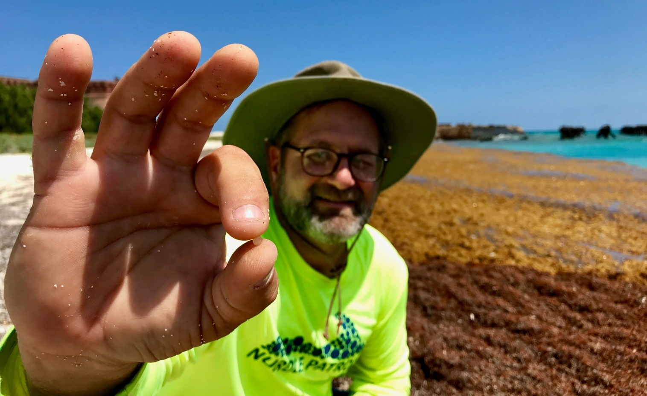
Latest stats
5,000+ Volunteers
11,300 Surveys
4,500 Sites
145 Partner Organizations
744 Teacher Kits
Notes:
As of January 2022, these are the stats for Nurdle Patrol. There are over 5,000 volunteers who have sent survey data in, with over 11,300 surveys performed across the U.S., Mexico, Central and South America, Canada, and Africa. Our main goal is making policy changes in the U.S., but anyone in the world can add data to the site. Over 4,500 sites have been sampled, and 145 partner organizations are involved with sampling. Seven hundred forty-four Teacher Kits have been sent to educators since February 2021.

Slide 16
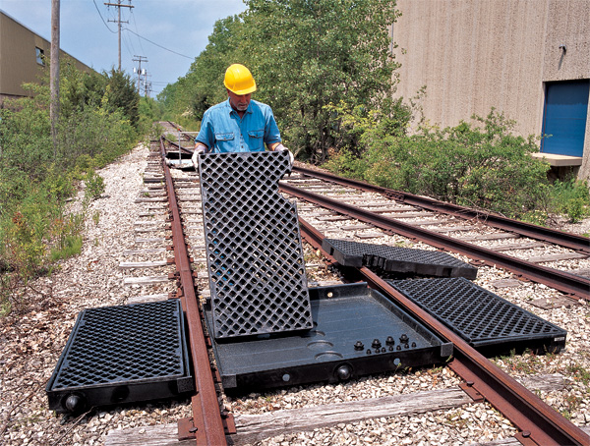
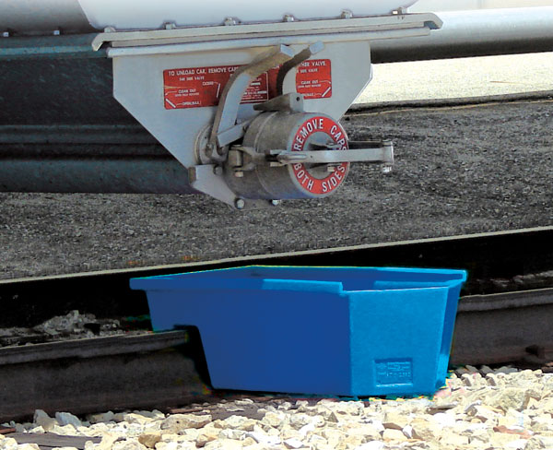
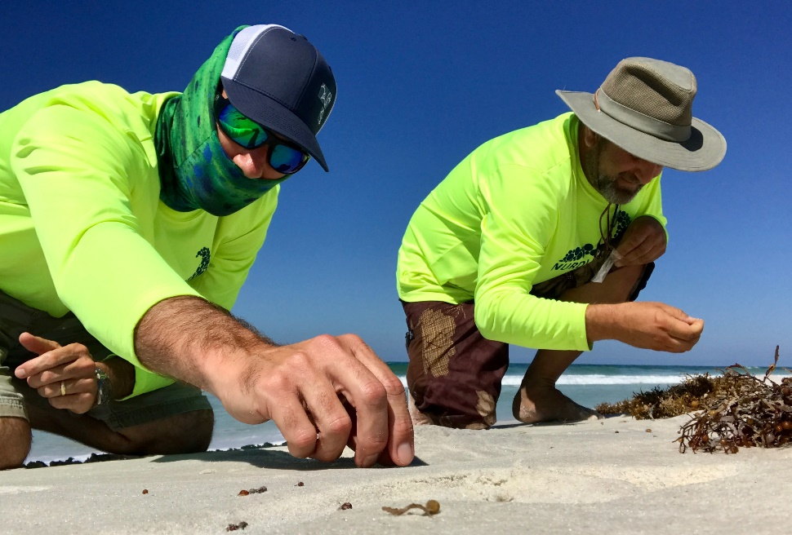
What can be done?
Follow the guidance of Operations Clean Sweep.
Stricter stormwater permits.
Develop data base to link nurdles to manufactures.
Create chain of custody for nurdles being shipped.
Quick accountability by plastic pellet industry.
Notes:
A number of actions can be taken to prevent pellets from getting into the environment, including stricter stormwater permits at the state level for any company handling plastic pellets. The Operation Clean Sweep is a voluntary program that the American Chemical Council developed about 25 years ago, and there are some good Best Management Practices (BMPs) included in it that states can make mandatory in permits. Some of these BMPs include simple measures by plastic manufacturers, such as placing catch buckets or grates where nurdles are being onloaded or offloaded, so that pellets never reach the ground.

Slide 17
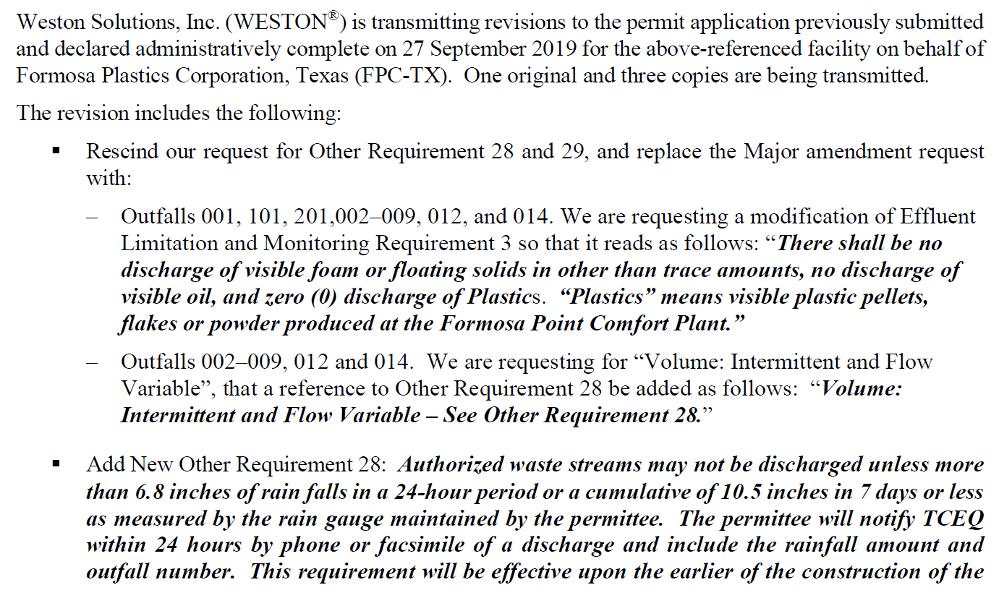
Discharge Permit Language
Notes:
This is example language from a discharge permit to modify vague language to say “zero plastic discharge”. This language should be inserted into all permits for plastic manufacturers and handlers in every state in the U.S. This is a great start to a solution to preventing plastics from reaching the ocean, and Nurdle Patrol data can be the justification for making these policy and rule changes.

Slide 18
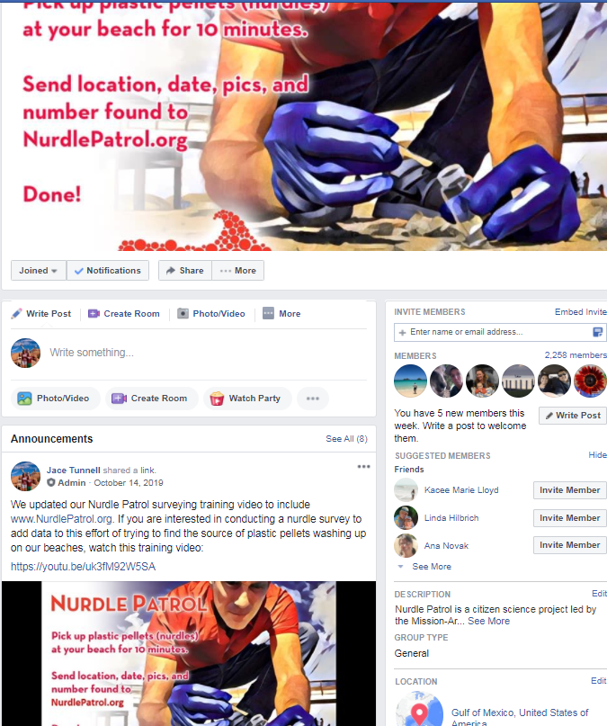

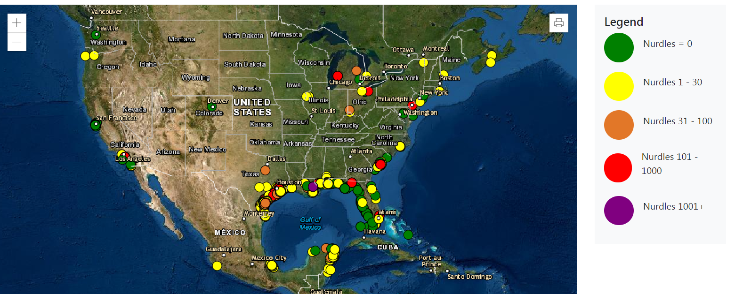
Facebook
www.nurdlepatrol.org
Notes:
Nurdle Patrol Facebook page is a place where citizen scientists post what they are finding and where, as well as sharing any new news that comes out about nurdles, including research, spills, lawsuits, etc. NurdlePatrol.org is where there are news stories, place to insert data, training videos, and the map that shows all data collected to date. These are tools to keep the Nurdle Patrol community engaged and informed about the latest activities. You can also follow us on Twitter @NurdlePatrol! We follow back!

Slide 19
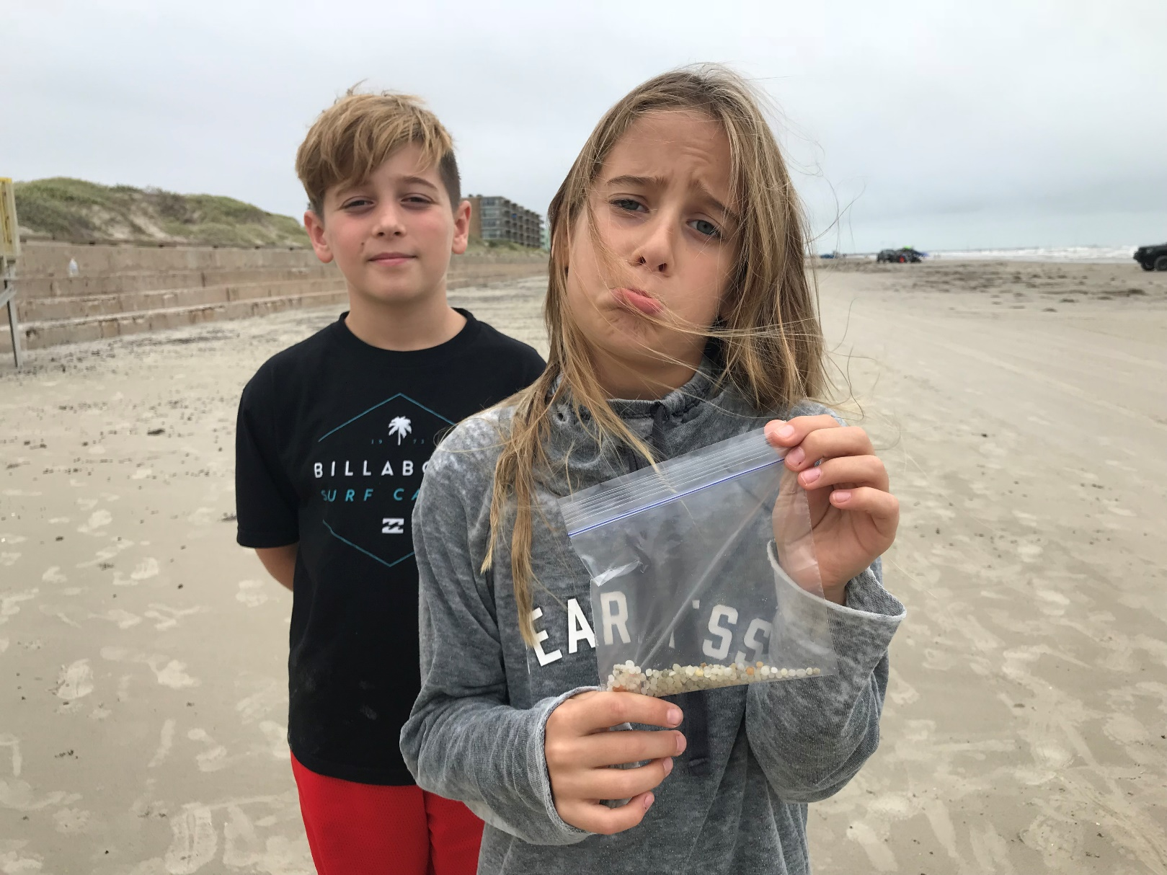
Why? Our next generation
Notes:
At the end of the day, we are doing this project for the next generation. Nurdles have been released into the environment for the past 70 years when plastic started to be mass produced. We have the knowledge now to see what is happening, the tools to see the impact, and the ability to make change so that our children and their children are not burdened with this pollution.

Slide 20
Thank you!
All Citizen Scientists!
Notes:
Thanks to all the citizen scientists and partners that make Nurdle Patrol happen!

